Slide 1
Avalanche
Snow Consensus Family
Cross-Chain Interoperability
Xunan Dai

Slide 2
Snow Consensus Family (2018)
A new family of consensus protocols, inspired by gossip algorithms
Features: Best of all worlds
Quick finality, low latency ( ~2 sec)
High throughput (1000-10000 TPS)
Scales (10k to 10m nodes)
Robust, no need for precise membership (Permissionless)
Quiescent, green, sustainable (PoS)

Slide 3
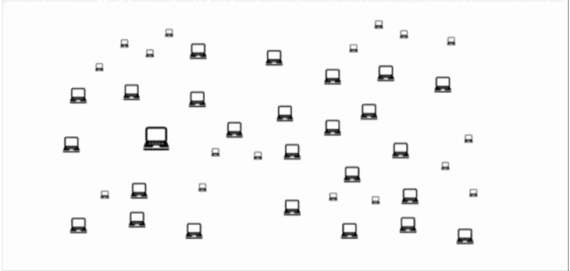
Operation
Goal: All node will be colored identically with high probability by setting a pair of appropriate parameters.
Like: 50/50 -> 51/49 -> 55/45 -> Ideal state “100/0”

Slide 4
Slush
Every node is honest, tx can not be changed
Sample k: 5 α：50% m: 10
1.
TX1
3.
TX2
Init color: TX1
2.
TX2
After m round
Accept TX2
Keep liveness, not safety
3 > 2: TX1 -> TX2

Slide 5
Snowflake
Sample k: 5 α：50% β: 30
1.
3.
TX1
TX2
3 > 2: TX1 -> TX2 , last color = TX2, cnt = 0
Init color = TX1, cnt = 0
2.
4.
TX1
TX1
3 > 2: keep TX1 , last color = TX1, cnt ++ = 1
cnt > β, Accept TX1
Keep safety, not liveness

Slide 6
Snowball (more efficient)
3.
TX1
Sample k: 5 α：50% β: 20
3 > 2: d[TX2] ++ = 1, d[TX2] ≯ d[TX1]: keep last TX1, cnt ++
1.
TX1
4.
TX2
Init = last color = TX1, cnt = 0, d[TX1] = 0, d[TX2] = 0
2.
5 > 0: d[TX2] ++ = 2, d[TX2] > d[TX1]: TX1 -> TX2, last color = TX2, cnt = 0
TX1
5.
TX2
3 > 2: d[TX1] ++ = 1, d[TX1] > d[TX2]: keep last TX1,
cnt ++
cnt > β, Accept TX2

Slide 7
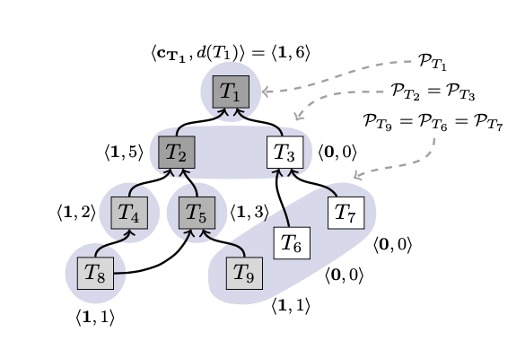

Avalanche (use Snowball in blockchain)
If no conflicting tx && its entire ancestry are preferred, chit = 1
else If collect k positive responses > α, chit = 1
d(T) = ∑(chit) (sum of chits in its progeny)
If d(T) > d(Preferred):
Pref = T
(update preferred tx of each conflict set)
UTXO Model
DAG structure

Slide 8
PoS in Avalanche
Proof-of-Stake is the method by which the AVA network prevents sybil attacks.
For Avalanche, any node can become validator, any validator of the subnetwork can propose Block / Vertex and send it to other validators to vote.
The more AVA staked, the more likely the validator to be sampled.
Every single participant in the staking protocol is rewarded equitably and proportionally based on proof-of-uptime and proof-of-responsiveness

Slide 9
Block / Vertex
Vertex is to DAG blockchain, using Avalanche Protocol as mentioned before.
Block is to linear blockchain, using Snowman Protocol, not in this scope.
Basically they're a collection of txs.

Slide 10
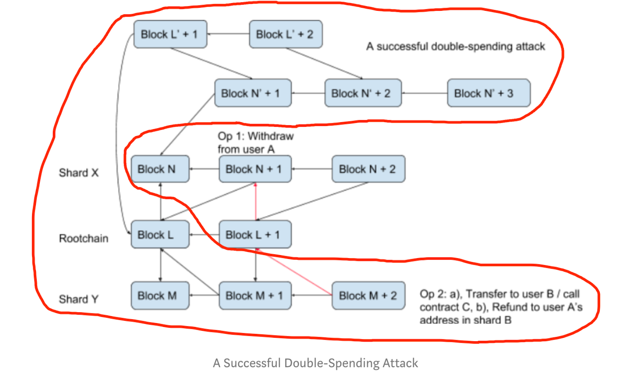
Avalanche vs Quarkchain
For Quarkchain,
We also use DAG structure, each minor block has two pointers: one links to the previous minor block in the shard and another one links to the latest root block.
Given two DAGs, we could easily determine which DAG should be chosen by using root-chain first fork rule.
We could optimize the system performance by using multi-threading or clustering

Slide 11
For Avalanche
By only providing two sub-graphs cannot decide which one is correct without other parameters.
Therefore, Avalanche needs timestamp to calculate chit, confidence … to finally decide which one is correct.
That is the major difference between with us.

Slide 12
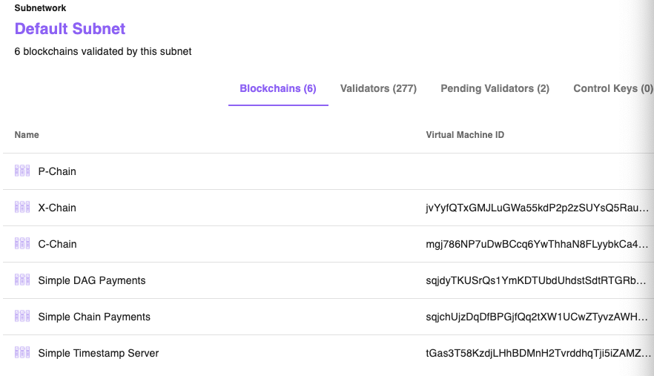
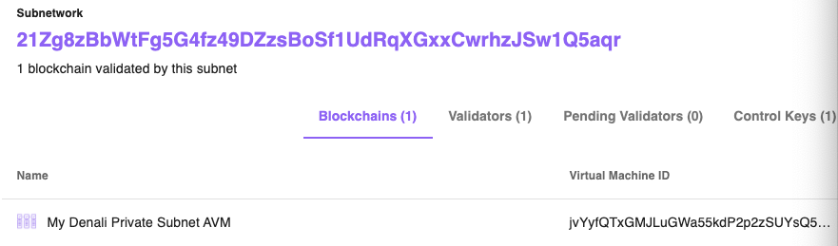
Subnetwork
A Subnet, or Subnetwork, is a dynamic set of validators working together to achieve consensus on the state of a set of blockchains. Each blockchain is validated by exactly one Subnet. A Subnet can validate arbitrarily many blockchains. A node may be a member of arbitrarily many Subnets.

Slide 13
Cross-chain (Default Subnet)
X-chain
P-chain
call: issueTx
curl -X POST --data '{
"jsonrpc": "2.0",
"method": "platform.issueTx",
"params": {
"tx":""
},
"id": 1
}' -H 'content-type:application/json;' 127.0.0.1:9650/ext/bc/P
call: exportAVA
curl -X POST --data '{
"jsonrpc":"2.0",
"id" :1,
"method" :"avm.exportAVA",
"params" :{
"to":"MvmGVpprbKQ9EBb7cTHaGVNbNjNMvCozu",
"amount": 10000,
"username":"freshmanD",
"password":"dai123456DD."
}
}' -H 'content-type:application/json;' 127.0.0.1:9650/ext/bc/X
call: importAVA
curl -X POST --data '{
"jsonrpc": "2.0",
"method": "platform.importAVA",
"params": {
"username":"freshmanD",
"password":"dai123456DD.",
"to":"MvmGVpprbKQ9EBb7cTHaGVNbNjNMvCozu",
"payerNonce":1
},
"id": 1
}' -H 'content-type:application/json;' 127.0.0.1:9650/ext/bc/P

Slide 14
Workflow
Each user of a node has a shared memory, including each blockchain’s shared memory
If transfer from X -> P:
Check user’s balance on X-chain > sending amount
If valid, issue a tx on X-chain -> Accept / Reject
P-chain loads tx info from X-chain’s shared memory
Add transfer amount on P-chain account, issue a tx on P-chain -> Accept / Reject
More like a Relay method, access the two chains’ shared memory and commit on each of them
Open Talk:
If X-chain reject, balance won’t change
If X-chain accept, P-chain reject, rebuild X-chain shared memory by deleting the rejected tx.
If X-chain accept, P-chain unknown, it’s like a malicious behaviour, the money will be costed as punishment.

